Slide 1

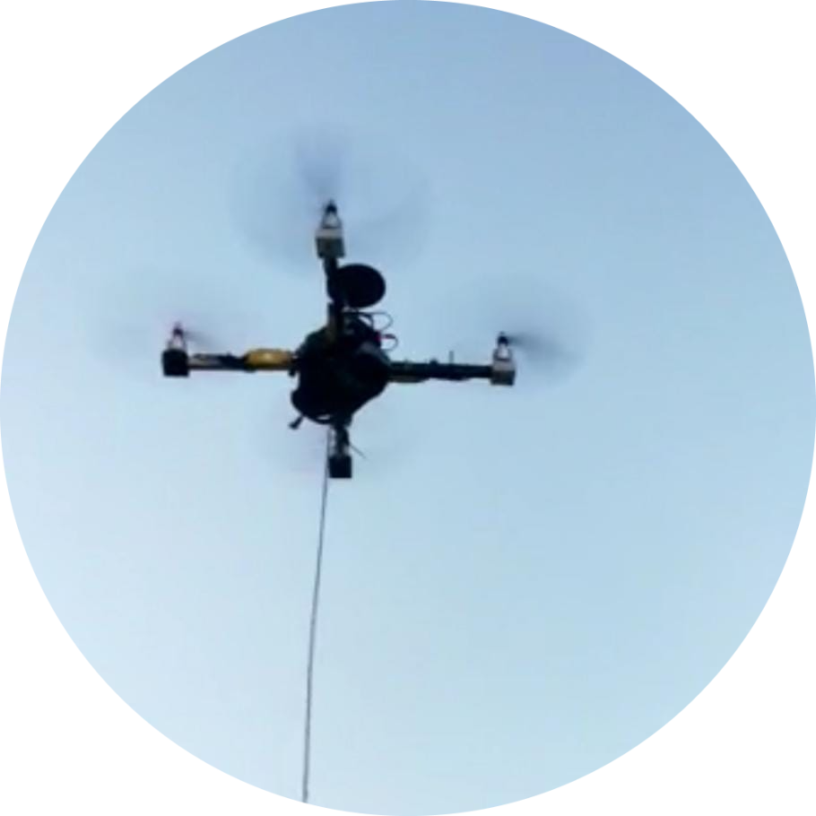
Embedded AI medical quadcopter
Under supervision of: Dr. Kareem Badawi
Dr. Mahmoud Hamed
Student names: Hend Emad Saber
Nada El-Sayed Hassan
Govani Sami George
Aliaa Magdy Abd Al-Ghany
Hager Ahmed Kotb

Slide 2
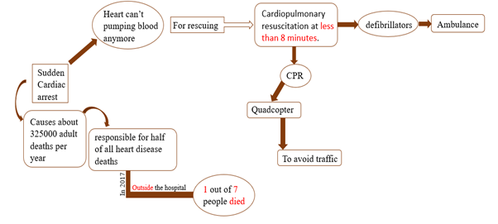
Problem definition
According to reference[1], the first drone for out of hospital cardiac arrest was proposed in Dec. 2021.
Reference:
[1] Fernández-Ruiz, I. (2021). Drone delivery of defibrillators for sudden cardiac arrest could shorten response times. Nature Reviews Cardiology, 18(11), 740–740. https://doi.org/10.1038/s41569-021-00618-0

Slide 3
System architecture
Quadcopter
Cardiac arrest prediction
Hardware components
Control
Landing image processing
Path planning
CPR

Slide 4

Cardiac arrest prediction
Path planning
Landing image processing
If someone may have a sudden cardiac arrest at any time
To autonomously go from its initial location to the patient location
To land on the right place for the CPR function

Slide 5
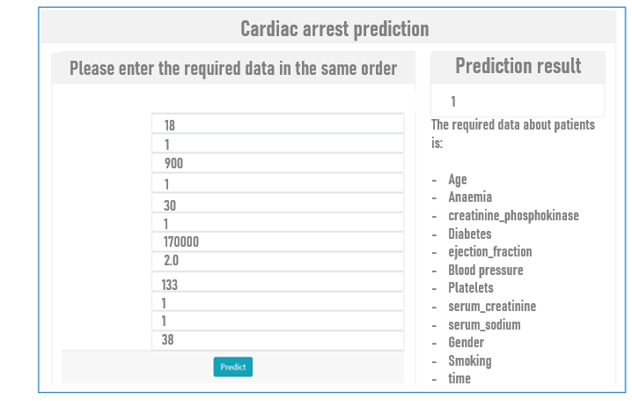
Cardiac arrest prediction

Slide 6
Cardiac arrest prediction (Supervised classification problem)
Data collection
Data cleaning
Exploratory data analysis (EDA)
Feature engineering
Modelling
Deployment
Hospitals dataset
Decision tree
Logistic regression
Random Forest
XGBoost
Flask framework

Slide 7
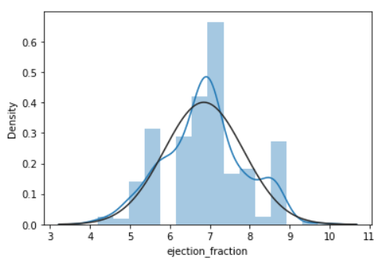
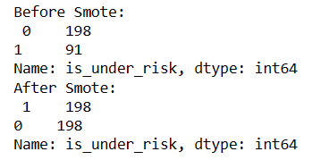
2. Data cleaning
Correlation
Normality
Box-Cox transformation
Data cleaning & EDA
Outliers removing
Balancing
Missing values
SMOTE technique
Box- Cox transformation: Sakia, R. M. (1992). The box-cox transformation technique: A Review. The Statistician, 41(2), 169. https://doi.org/10.2307/2348250

Slide 8
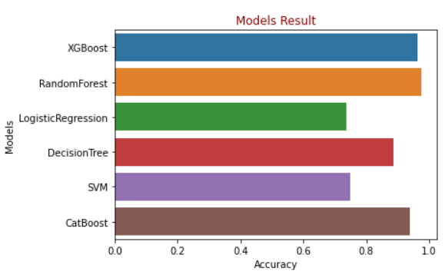
5. Modelling
Logistic regression
Modelling
Decision tree
97.5%
Random forest
With accuracy of
XGBoost

Slide 9
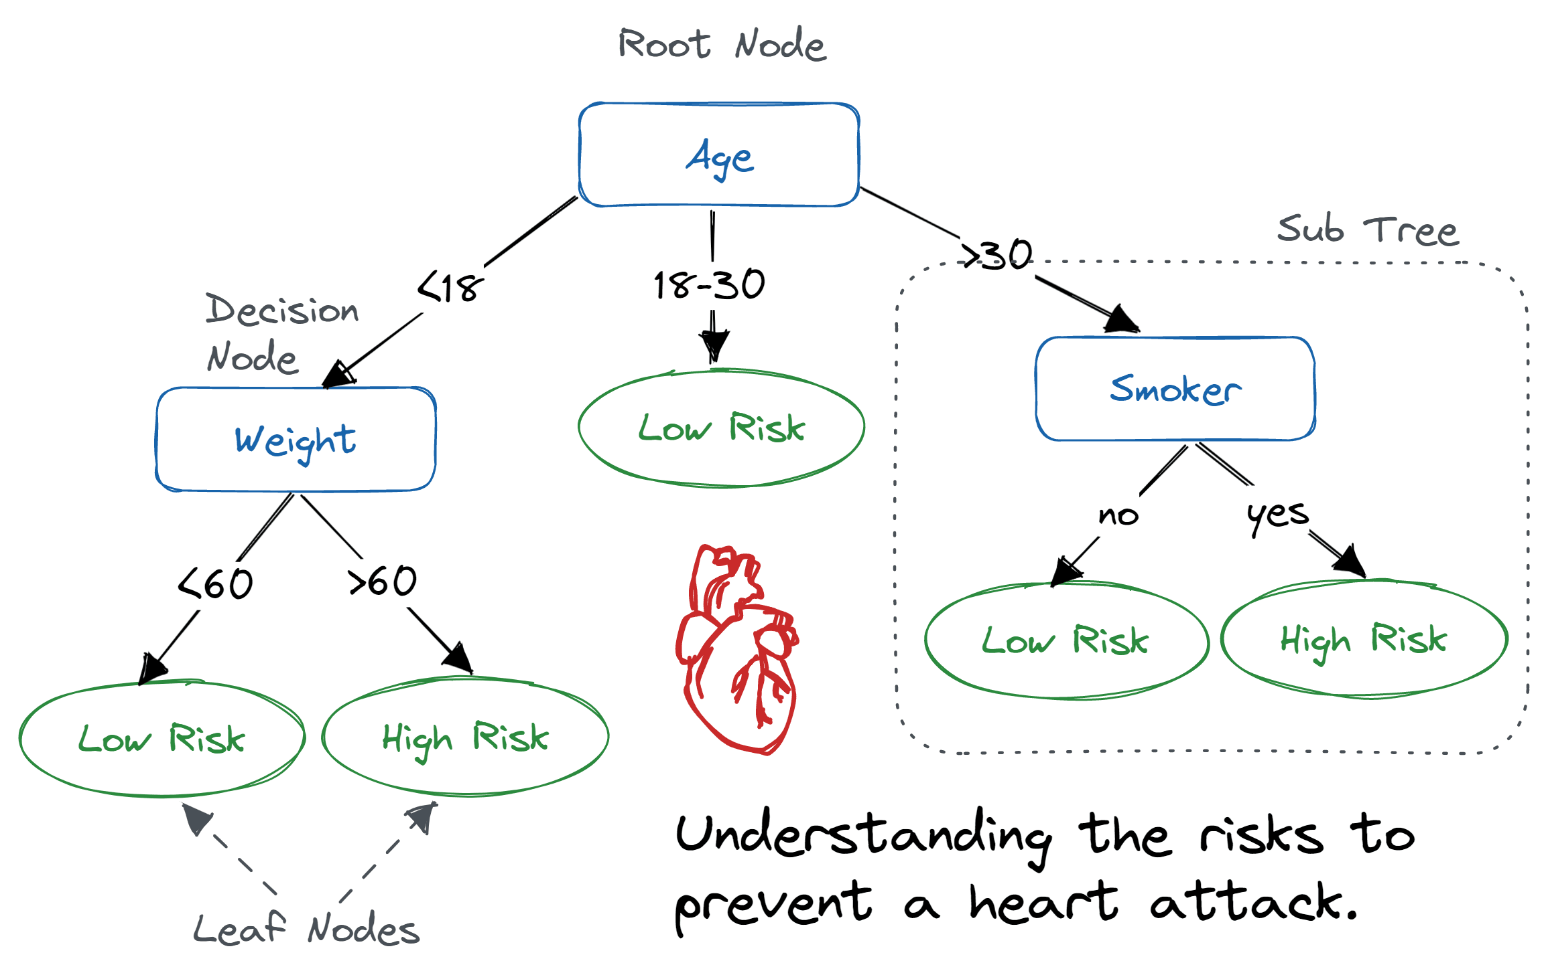
Random Forest algorithm
A tree ensemblele algorithm, based on building a bunch of decision trees and apply voting between their results them to predict the right class (If with high possibility for cardiac arrest or not).
How does this work and how do these decision tress is built?

Slide 10
Random forest logic
When does creating the decision trees stop?
1. When decision tree splitting tops when reaching the maximum depth value that is given to the algorithm.
2. Or when the number of decision trees reached maximum which is also given to the algorithm.
Applying bagging (sampling with replacement technique)Choose random k features which are $\sqrt{\begin{aligned}The total number of \\ features \\ in the dataset\end{aligned}}$
Applying bagging (sampling with replacement technique)Choose random k features which are √(█(𝑇ℎ𝑒 𝑡𝑜𝑡𝑎𝑙 𝑛𝑢𝑚𝑏𝑒𝑟 𝑜𝑓 @𝑓𝑒𝑎𝑡𝑢𝑟𝑒𝑠 @𝑖𝑛 𝑡ℎ𝑒 𝑑𝑎𝑡𝑎𝑠𝑒𝑡))
Choose the feature with the maximum reduction in impurity to split the values of the features on.
Apply voting for the total produced decision trees.
The given best hyperparameters values are calculated using cross validation techniques.

Slide 11
6. Deployment
Using flask framework

Slide 12
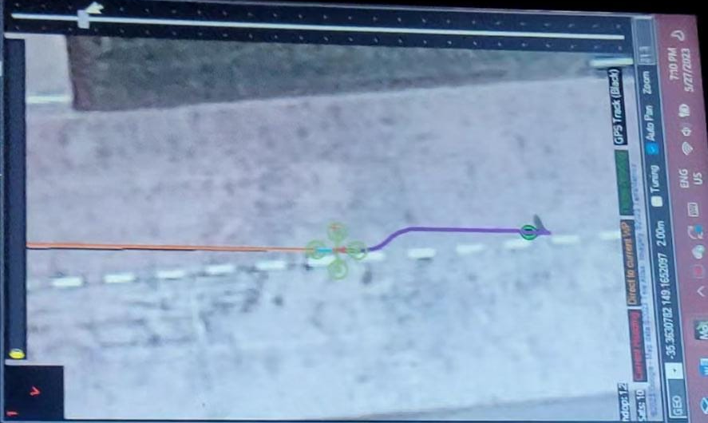
Path planning
References:
[1] Veras, L. G., Medeiros, F. L., & Guimaraes, L. N. (2019). Systematic literature review of sampling process in rapidly-exploring random trees. IEEE Access, 7, 50933–50953. https://doi.org/10.1109/access.2019.2908100
[2] Gugan, G., &amp; Haque, A. (2023). Path planning for autonomous drones: Challenges and future directions. Drones, 7(3), 169. https://doi.org/10.3390/drones70301 69
[3] LaValle, S.M., 1998. Rapidly-exploring random trees: A new tool for path planning.

Slide 13
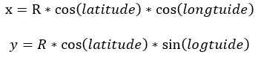
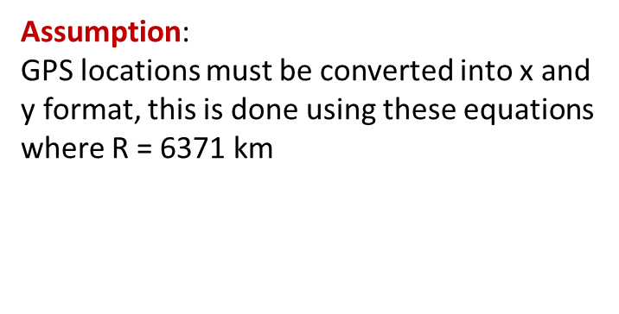
Path planning
Produced the path in 6 seconds
RRT* Algorithm
Informed RRT* Algorithm
After
optimization
The drone reached the goal of 7m in 22 seconds using SITL Simulation
Ellipse sampling technique
The drone reached the goal of 7m far from the start in 22 seconds
(6seconds of path calculations and 14 seconds for movement with speed 0.5 m/sec)
Assumption:
GPS locations must be converted into x and y format, this is done using these equations where R = 6371 km$=R∗\cos\left(latitude\right)∗\cos\left(longtuide\right)$
$$y=R∗\cos\left(latitude\right)∗\sin\left(logtuide\right)$$

Slide 14
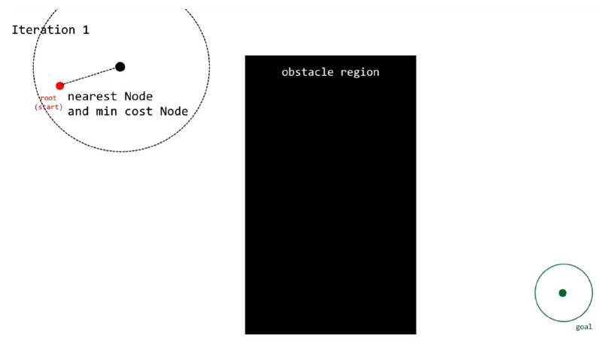
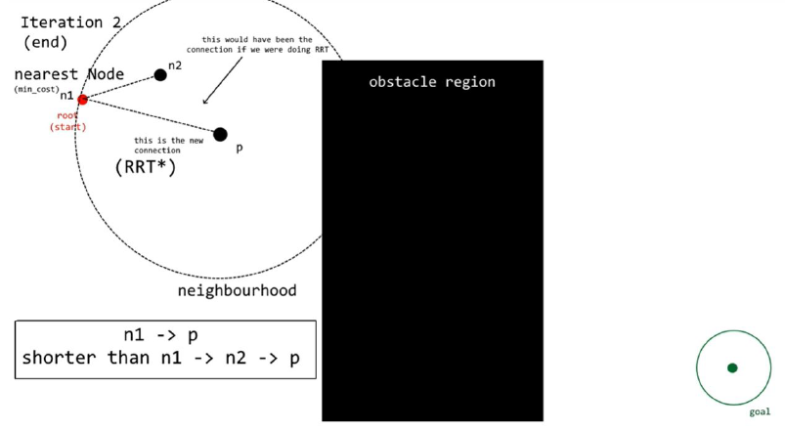
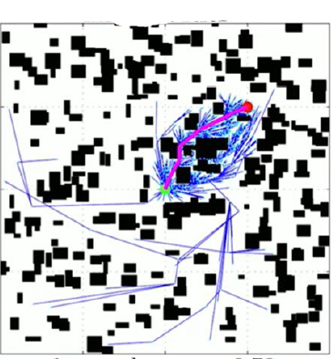
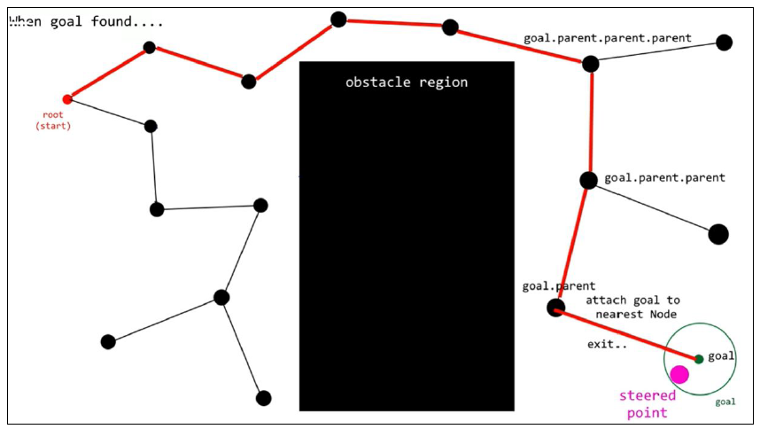
Path planning using RRTs logic:
After applying the ellipse sampling technique

Slide 15
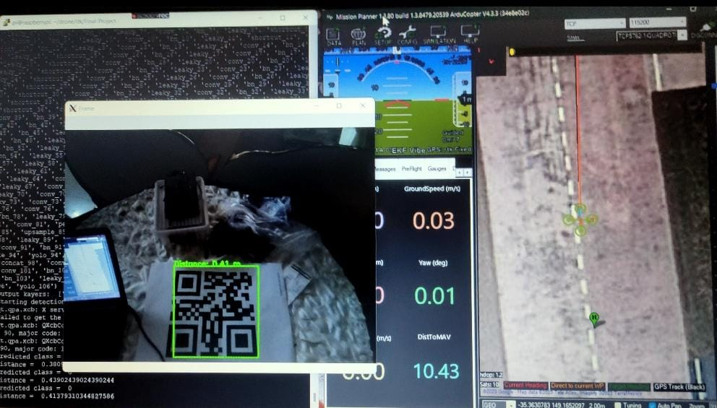
Landing image processing

Slide 16
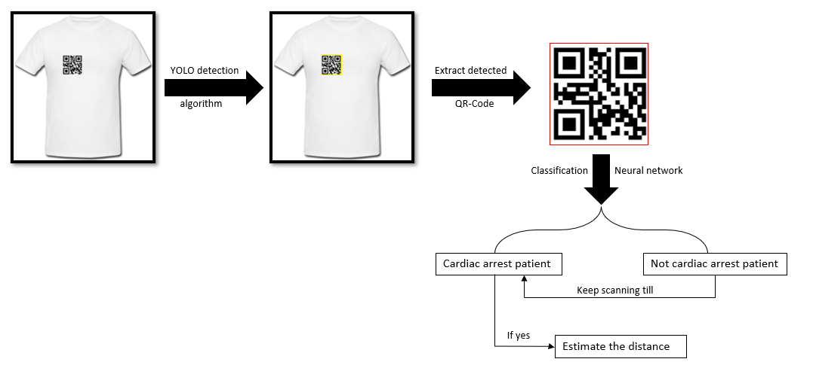
Landing image processing
(With acuuracy of 100%)

Slide 17

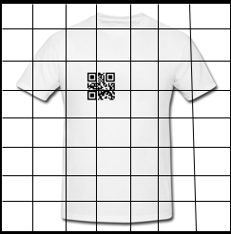

YOLO algorithm
97% 5%
39% 55%
Produce vector (label)
Using
neural networks
Class probability map

Slide 18
Classification
Conv2d layer
Max pooling layer
Conv2d layer
Max pooling layer
Classification model
Dense layer
Flatten layer
Dropout layer
Compression
For decreasing the model size to reduce time and power consumption

Slide 19
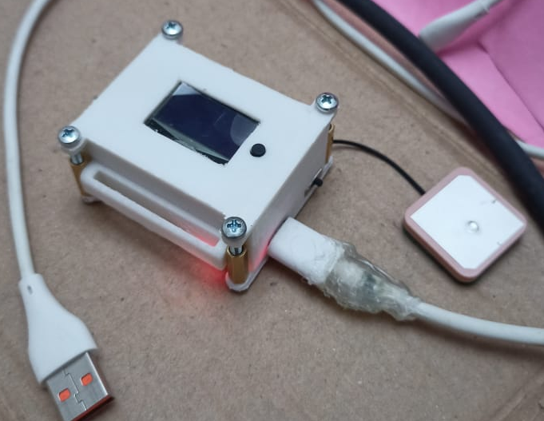
Heart Rate monitor watch

Slide 20

Heart rate monitor watch
overview
A watch is a wearable technology that is designed to monitor the wearer's heart rate in real-time which can be an early warning sign of cardiac arrest.
PURPOSE
In the case of the heart rate sensor detect stopping patient’s heartbeat the watch publishes the patient’s location to the server that can be a valuable tool for helping the drone locate the patient quickly.

Slide 21
Proposed design
ESP8266
MAX30102 sensor
MAX30102 sensor
OLED Display
Adafruit IO

Slide 22
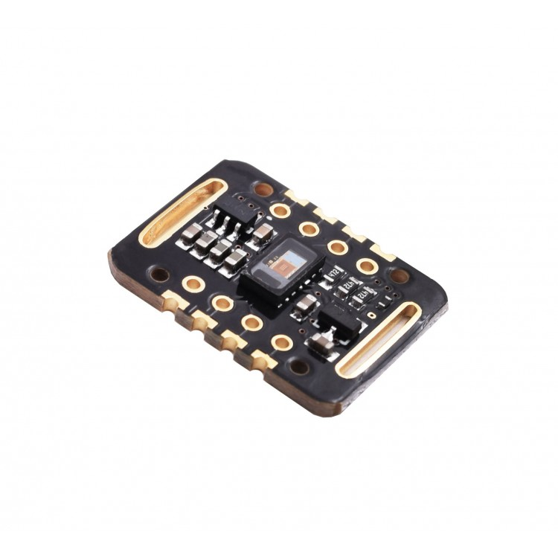
MAX30102 Heart Rate and Pulse Oximeter Sensor
The sensor is an I2C-based used as both a heart rate monitor and a pulse oximeter.
Vcc (works on 3.3V )

Slide 23
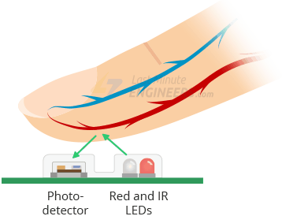
How MAX30102 Sensor Works?
Integrates photodetector, RED and IR leds.
using a technique called photoplethysmography (PPG)
As the blood is pumped through the finger with each heartbeat
creating a changing waveform at the output of the photodetector

Slide 24
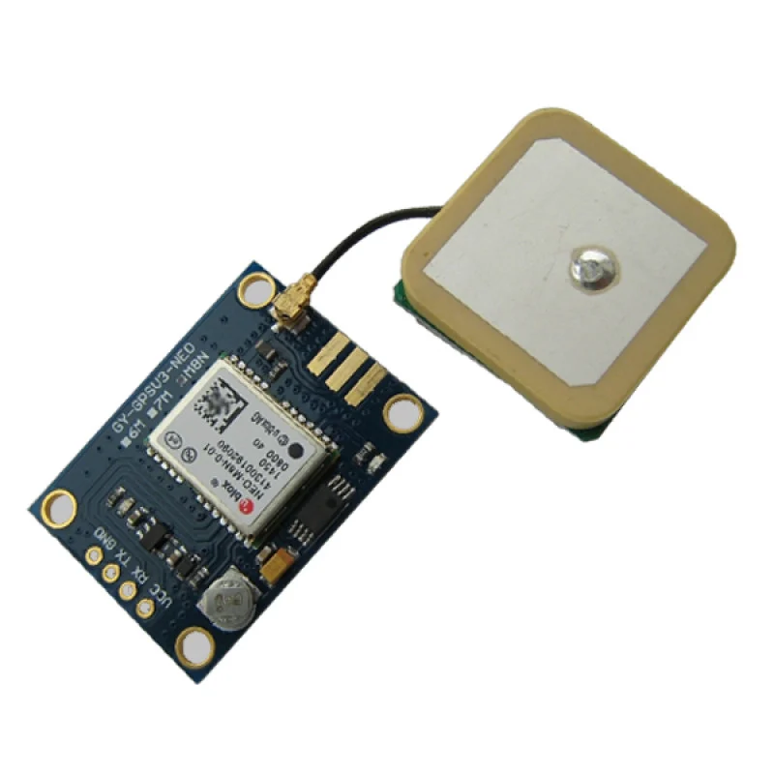
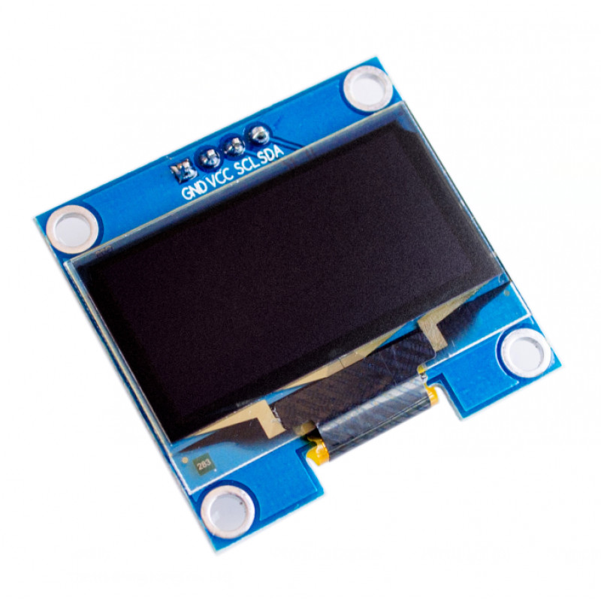
Ublox NEO-M8N GPS
It uses the Global Navigation Satellite System (GNSS)
supports UART communication protocol
powered using a 3.3V or 5V
OLED Display
have an I2C interface

Slide 25
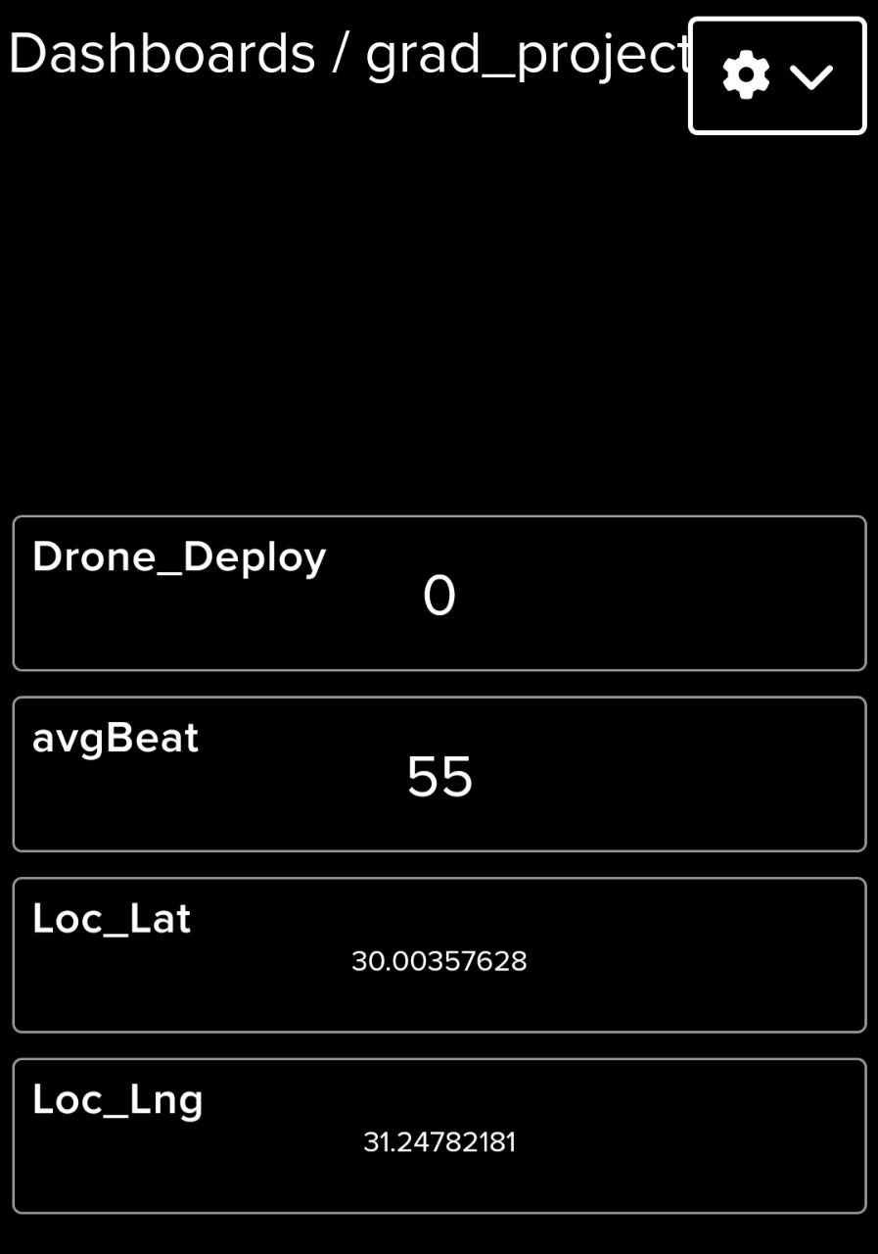
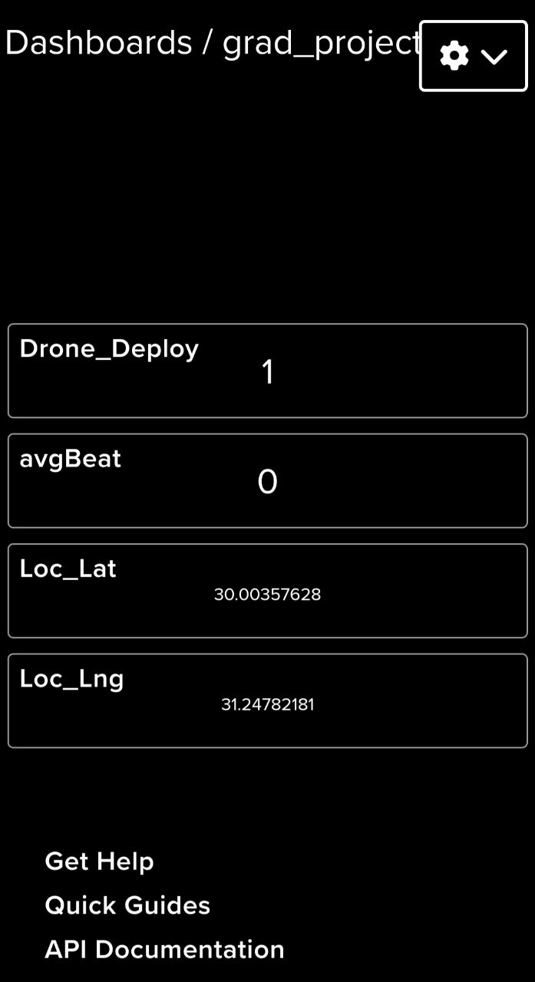
Adafruit connection
ESP8266
The sensor sends data
Publish Using MQTT
If button pressed
Publish Using MQTT
Oled display

Slide 26
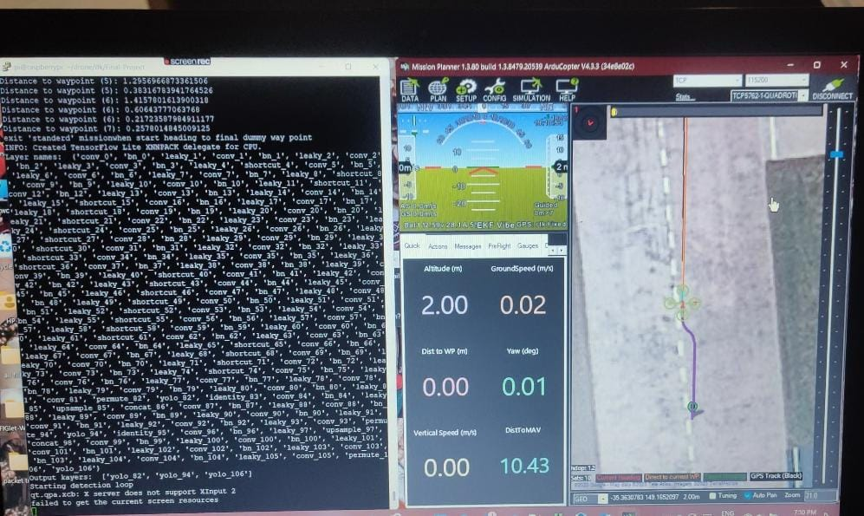
Drone control

Slide 27
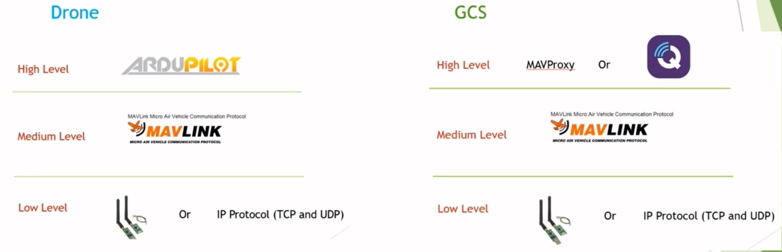
A Ground Control Station (GCS) is a software used to remotely control and monitor a drone. It provides real-time telemetry data and video footage, allowing the operator to control the drone's flight path and settings.
GCS
MAV LINK

Slide 28
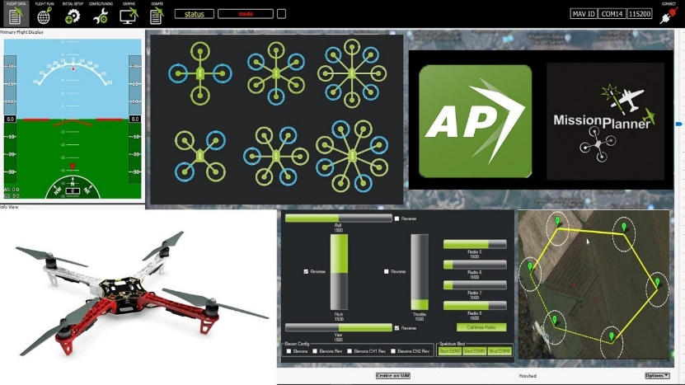
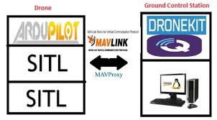
The project is carried out in several stages, starting with the development of the drone control script and testing it using software in the loop(SITL). The project also involves monitoring the battery health and EKF parameters of the drone and identifying potential barriers or problems that may arise during testing.

Slide 29
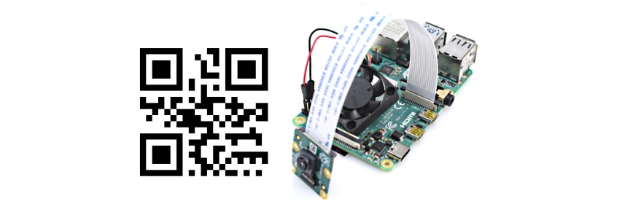
The Rpi4 is then connected to a camera and Xserver to enable QR code landing.
Xming

Slide 30

Finally, the project is completed by connecting all remaining parts of the project using a server and Bluetooth.
Accessing Watch is achieved using IO server which includes subscribing to the heartbeat data of a patient watch and detecting arrhythmic cases.
Accessing CPR is achieved using Bluetooth, and a message is sent to start its function.
RPI 4
Cloud IO server
Bluetooth

Slide 31


Add redundant sensors to ensure that the drone can continue flying even if one system
Distribute the processing across multiple boards on the Raspberry Pi 4 to improve performance in case of processing large amount of data or perform complex calculations.
Implement real-time monitoring of critical drone parameters such as battery level, altitude, and speed; to alert you to any potential safety issues. This is done using yocto GUI.
Use backup communication if the primary communication link between the drone and the

Slide 32
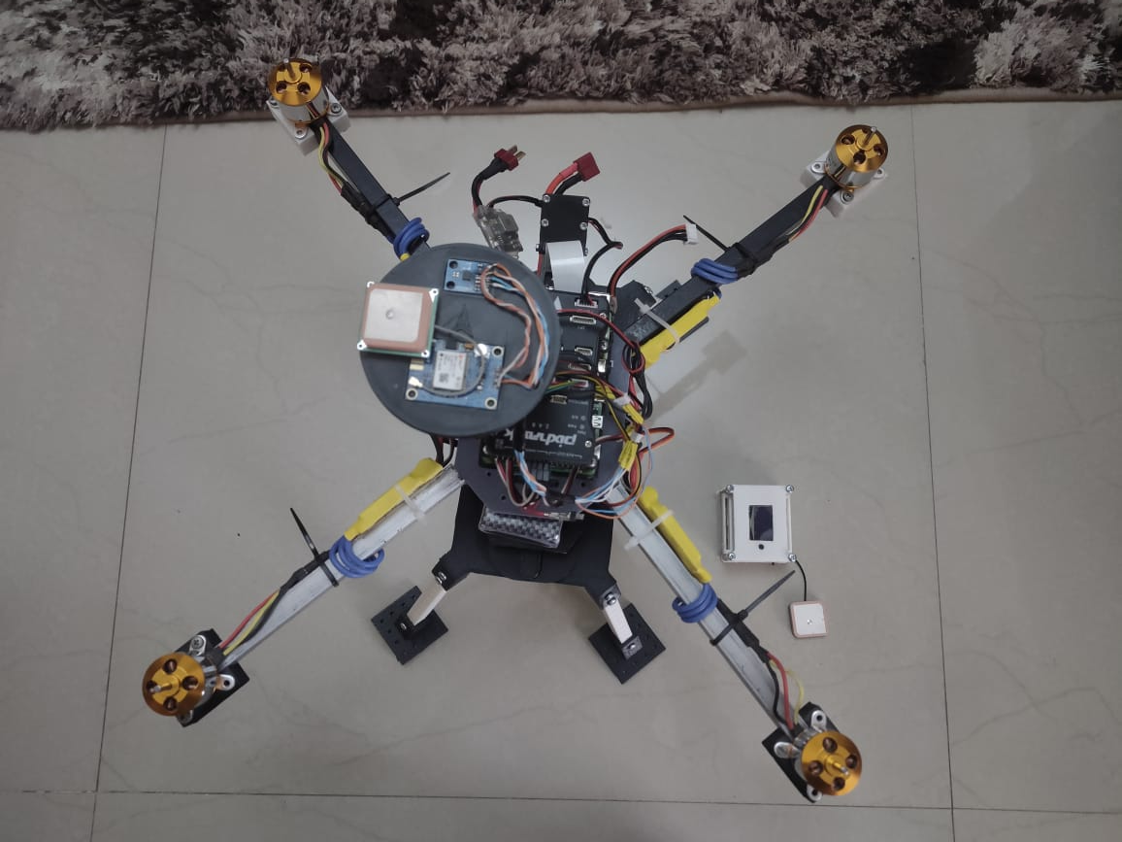
Pixhawk and Drone Connection

Slide 33
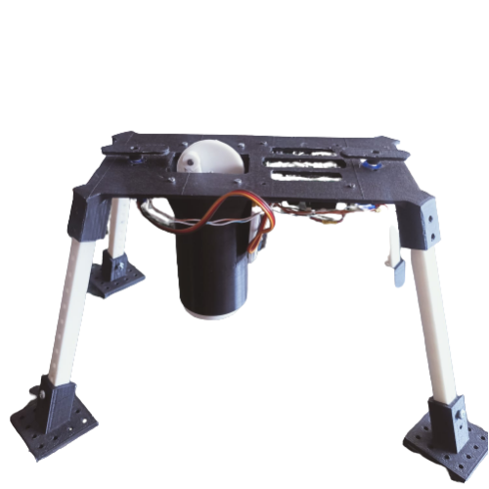
CPR (Cardiopulmonary Resuscitation)

Slide 34
CPR based on AVR microcontroller
Introduction
CPR is a technique used to maintain blood flow by chest compression when the heart has stopped functioning.
AVR
Bluetooth module
switches
DC Motor
Servo motor

Slide 35
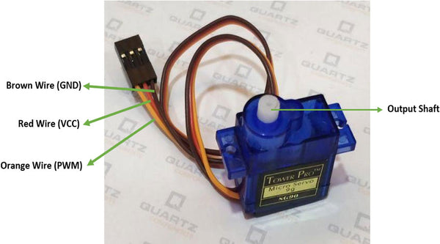
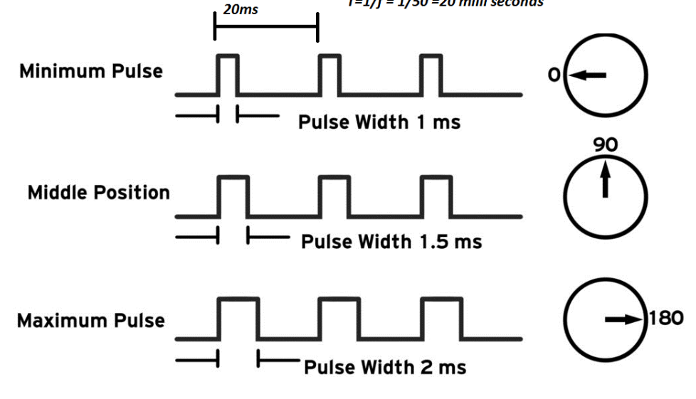
1-Servo motor
Used for separating CPR part from drone
PWM signal needed

Slide 36
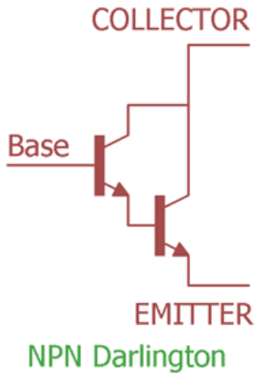
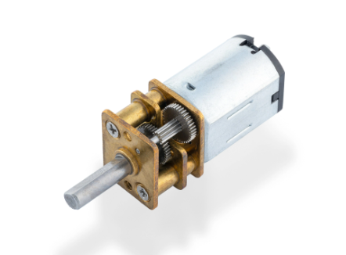
2-DC Motor
Using N20 DC motor for automatic chest compression
Using Darlington with motor as a switch
provides high current gain, allowing it to handle the current requirements of the DC motor.

Slide 37
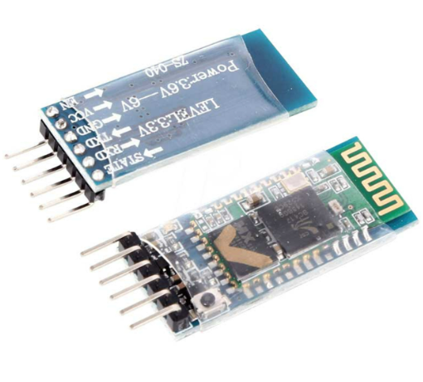
3-Bluetooth module
HC05 Bluetooth module used for wireless communication between AVR microcontroller and Raspberry pi
Communicate with AVR via UART
Operate on 5v and 3.3v

Slide 38
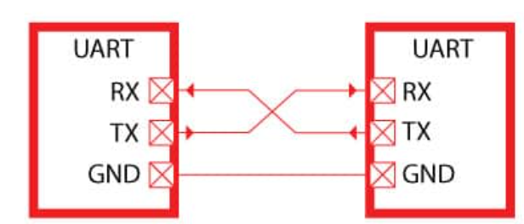
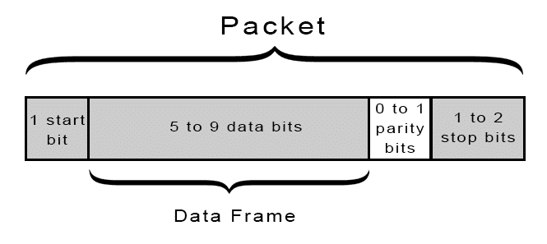
USART(Universal serial asynchronous Receiver transmitter)
USART connection
Frame format

Slide 39
4-Switches using interrupt
Interrupt
Specific interrupt enable
Interrupt controller
ON DATA BUS
Processor
Vector table in flash
Global interrupt enable
Interrupt ID
Peripheral interrupt flag

Slide 40
If switch1 pressed
If switch2 pressed
Low on INT0 pin
Low on INT1 pin
Execute inside ISR0 (rotate servo motor 90)
Execute inside ISR1 (working or stopping CPR)

Slide 41
Flowchart
start
Initialize pin direction and values
Initiate Timer1,EXTI0,EXTI1
Read a received data
If data=2
False
If data=1
True
Stop DC motor
Rotate servo 90 degree then start DC motor

Slide 42
Future plan
The Quadcopter can be used in unknown environment by applying SLAM algorithm and using RPLidar. It also may also include feature extraction algorithm to be able to act in dynamic environment .
Implement real-time monitoring of critical drone parameters such as battery level, altitude, and speed; to alert you to any potential safety issues.
Connect the watch with a smartphone this enable communication features such as calls, text messages, and notifications. This allows users to stay connected without having to reach for their smartphone.
connect sensor to detect whether compressions are being performed correctly and sensor to measure the force of compression.

